Slide 1
Presentation for Action Ridge June 2023
AJ Conroy
State Law Audit Project
stateoutreach@eracoalition.org
312.405.4538

Slide 2
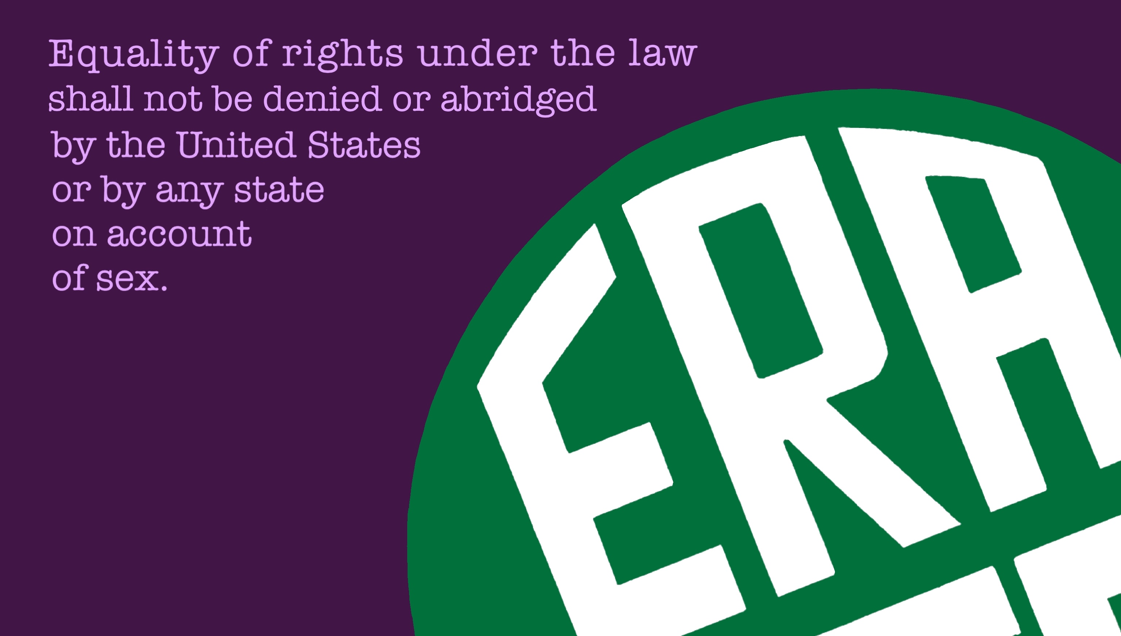

Slide 3

The ERA Coalition was founded in 2014 to bring concerted, organized action to the effort to ratify the Equal Rights Amendment. The ERA Coalition has a sister organization, the Fund for Women’s Equality, which promotes public education and outreach on the need for constitutional equality. Composed of more than 280 organizations across the country, the Coalition provides education and advocacy on Constitutional Equality.
While the effort to amend the Constitution to include sex equality began nearly a century ago, our renewed efforts are centered on women of color (African American, Asian American/Pacific Islander, Latina, and Native American), gender-nonconforming and transgender women and girls, and nonbinary people – those who are most impacted by systemic inequities.

Slide 4
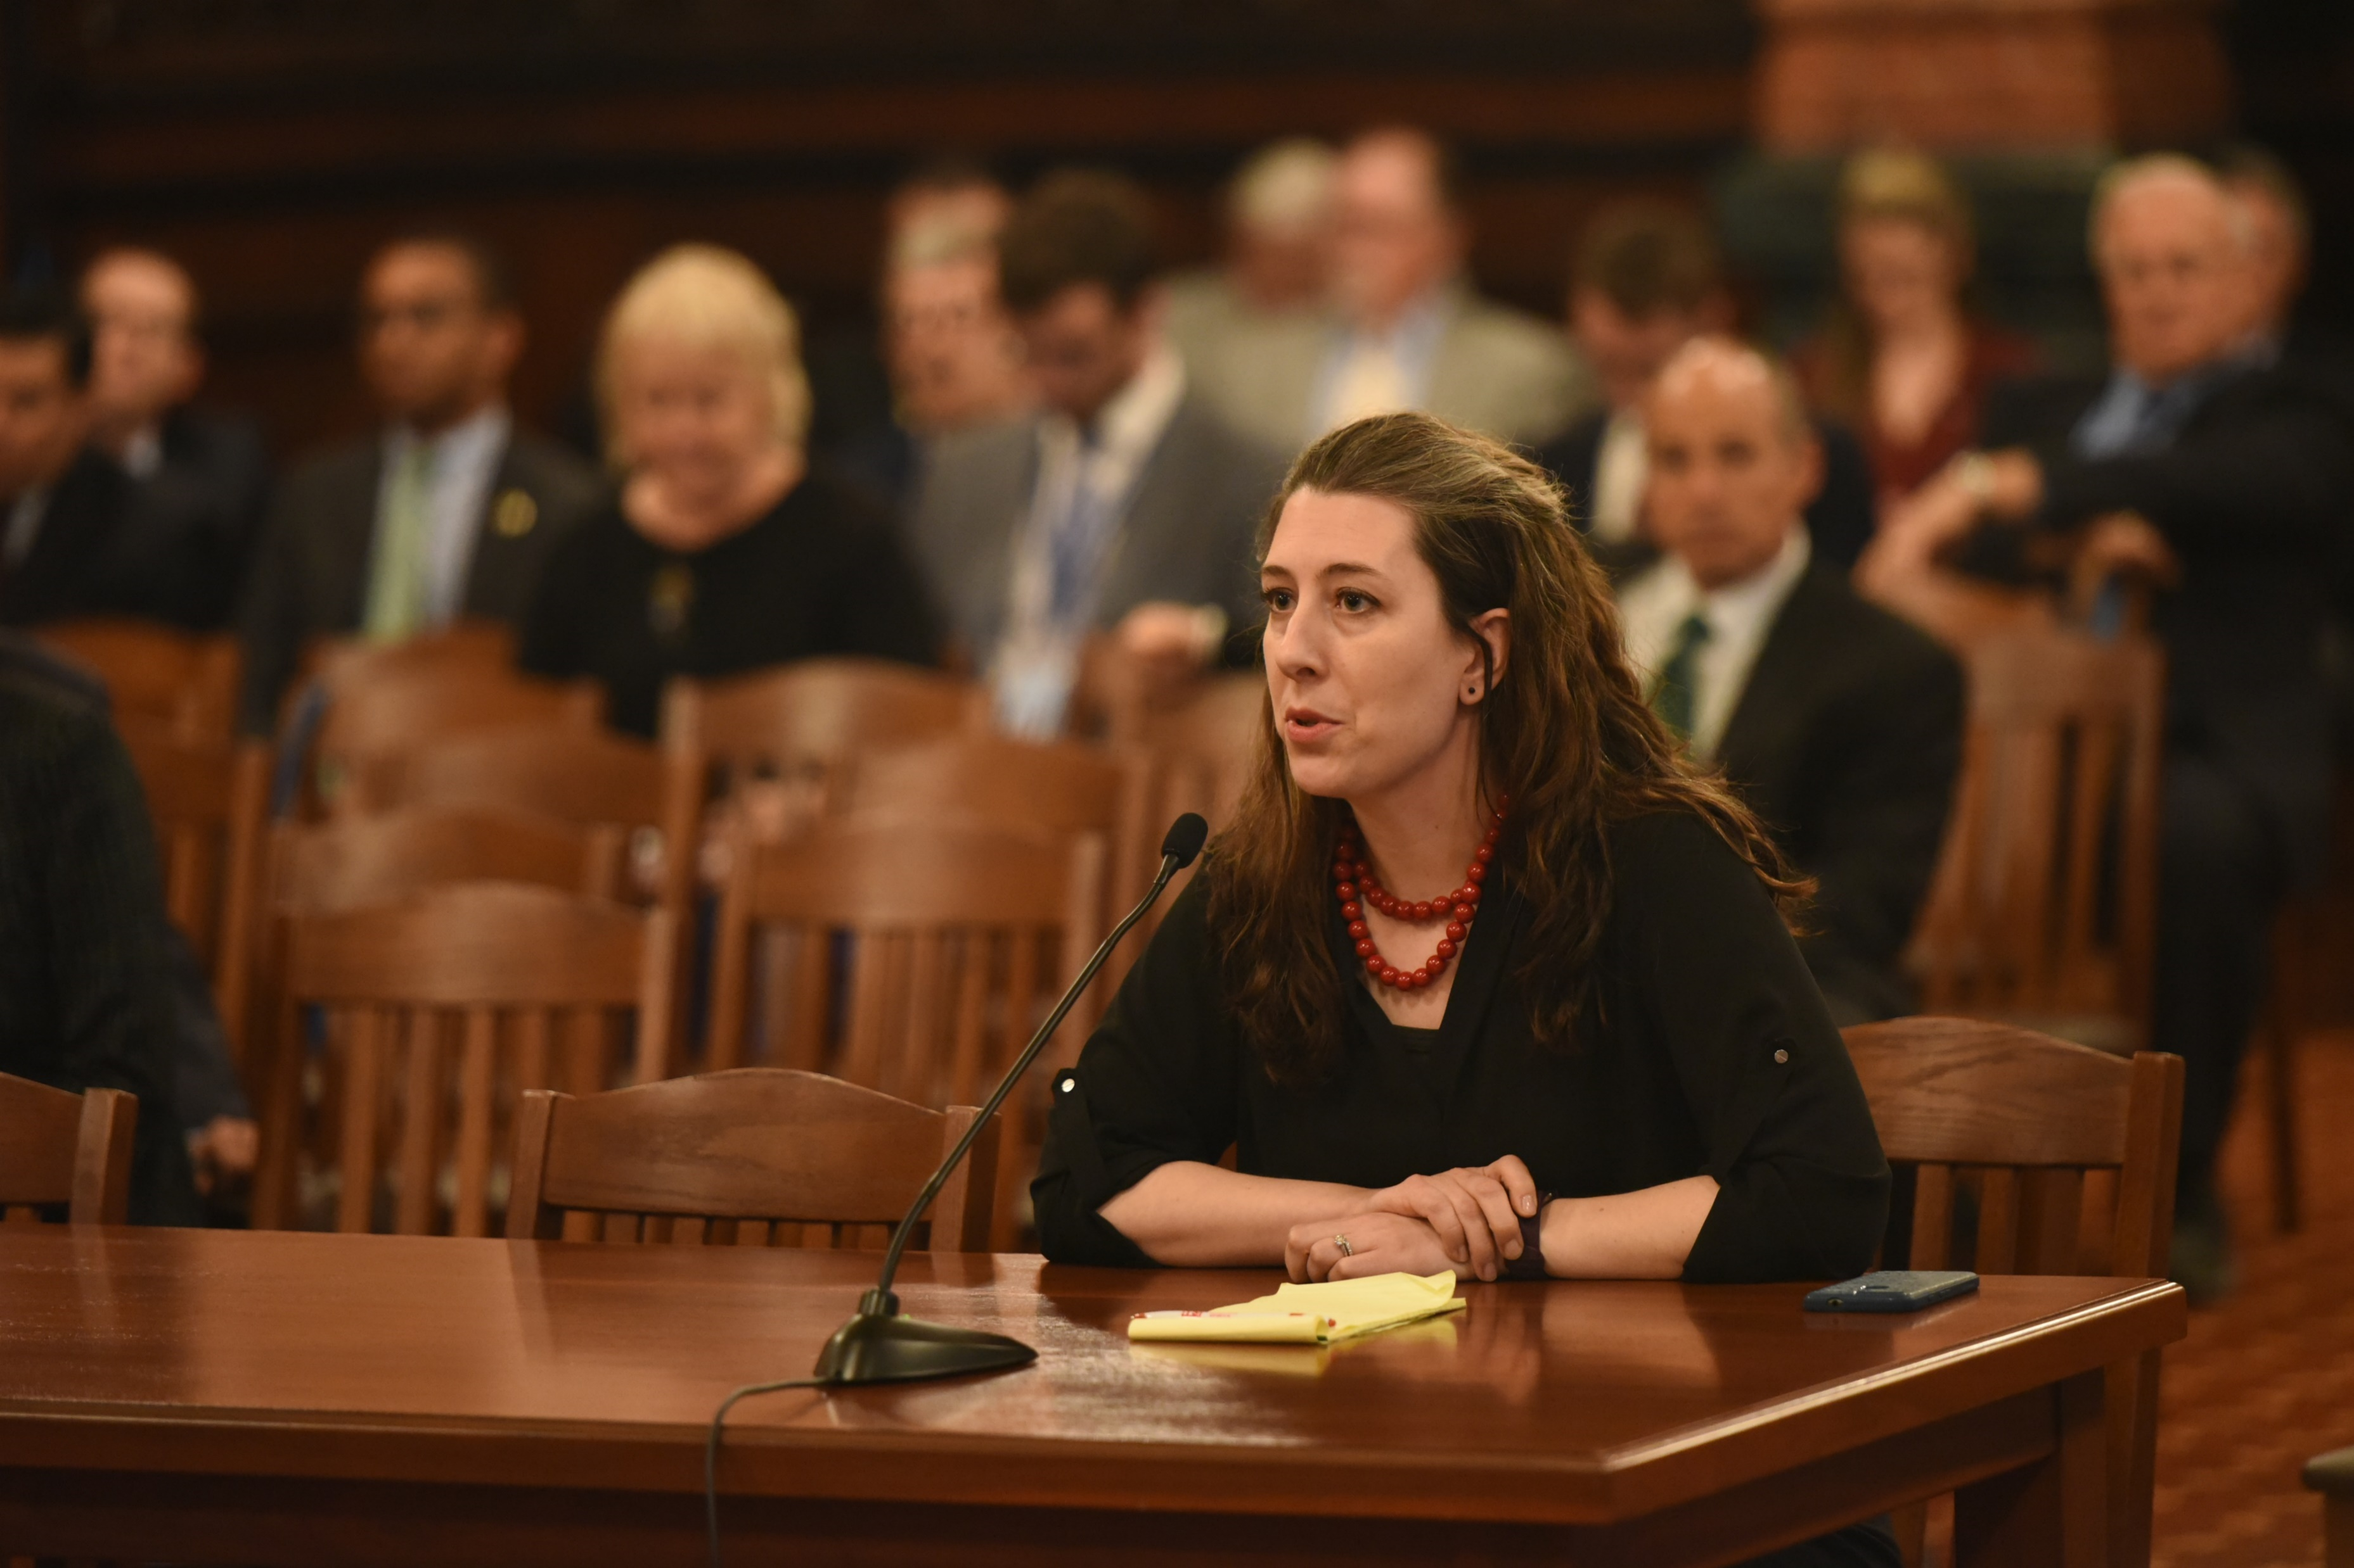
AmyJo Conroy is an attorney practicing in Illinois. Her favorite superhero is She-Hulk.
Coordinates a State Law Audit Project for the ERA Coalition.

Slide 5

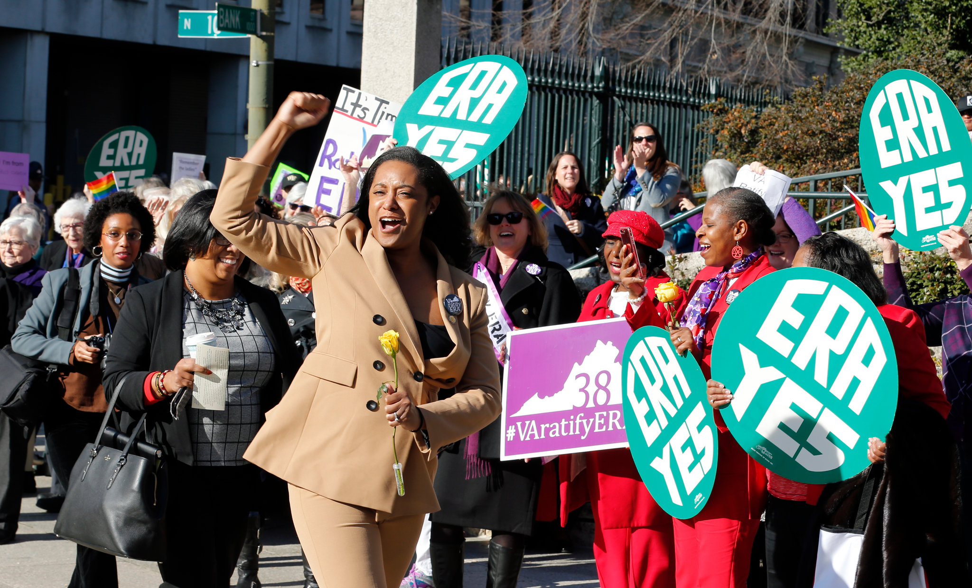
Article V complete

Slide 6
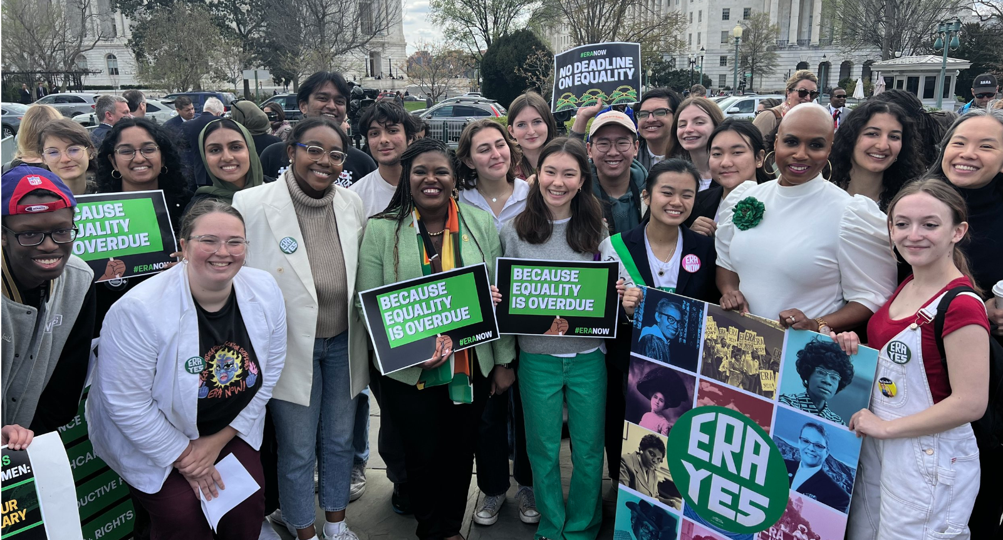
Capitol Hill, March 2023

Slide 7
STATES
Affirm the 28th Amendment is ratified
California, Colorado, Hawaii, Illinois and Minnesota passed resolutions declaring the ERA is fully ratified.
More states introduced affirming resolutions such as Arizona, Georgia, Indiana, Massachusetts, Michigan, Minnesota, New Jersey, New Mexico, New York and Tennessee.
State ERAs – New York, Minnesota, Oregon and Maine

Slide 8
CONGRESS
SJRes 4
HJRes 25
ERA Caucus
5th largest caucus
Affirms the ERA is ratified

Slide 9
What you can do:
Thank our legislators in Congress – HJRes 25
  Handwritten notes, Facebook, Twitter
Thank our legislators in Springfield – HJRes 20
Handwritten notes, Facebook, Twitter
Awareness Outreach
Follow @ERAcoalition, @ERAillinois and signal boost
Voter Report Card

Slide 10
What Action Ridge can do:
    Senator Tammy Duckworth
    Representative Nikki Budzinski
    Governor JB Pritzker
    Representative Lauren Underwood

Slide 11
Inspire
Netflix
  My Name is Pauli Murray
  What the Constitution Means to Me
  Amend (episode 4)
Book for teens – Ordinary Equality by Kate Kelly
“Artists 4 ERA” art exhibit www.artists4era.org
Podcast - Season 1 of Ordinary Equality on Wonder Media
Book Group – “Do Everything” about Francis Willard

Slide 12

AJ Conroy
State Law Audit Project
stateoutreach@eracoalition.org
312.405.4538

Slide 13
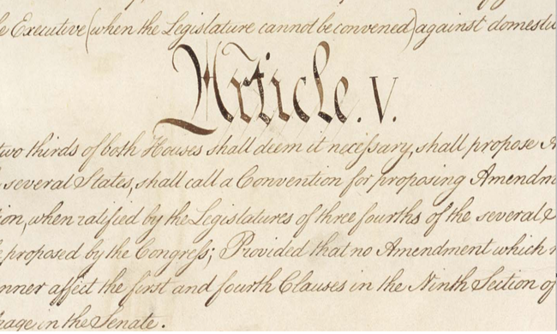
Ratification Process
“The Congress, whenever two thirds of both Houses shall deem it necessary, shall propose Amendments to this Constitution, or, on the Application of the Legislatures of two thirds of the several States, shall call a Convention for proposing Amendments, which, in either Case, shall be valid to all Intents and Purposes, as Part of this Constitution, when ratified by the Legislatures of three fourths of the several States…”
U.S. Constitution, Article V

Slide 14
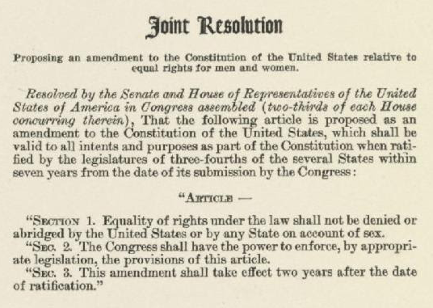
The Time Limit
“… within seven years from the date of its submission by the Congress”
Passed by Congress on March 22, 1972

Slide 15

Rescissions
Nebraska
Tennessee
Fourteenth Amendment
Ohio and New Jersey claimed to rescind their ratifications; their claim had no impact.
Fifteenth Amendment
New York claimed to rescind its ratification; their claim had no impact.
Nineteenth Amendment
Tennessee ratified the 19th Amendment and later claimed to rescind the ratification. The recission was rejected in Leser v. Garnett.
Purported “Rescissions”
Kentucky
South Dakota
North Dakota
Nebraska
Tennessee
Idaho

Slide 16
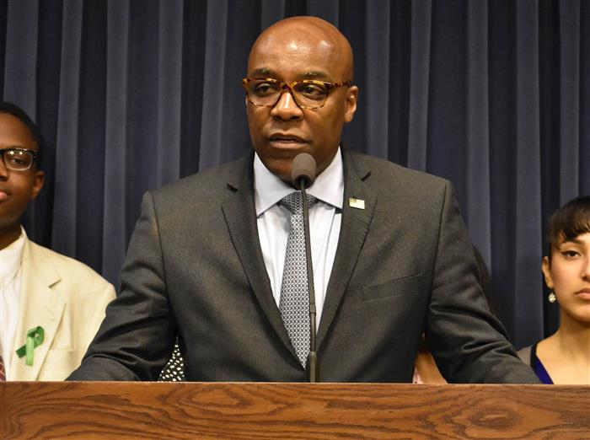
Litigation History
Tennessee
Idaho
Kentucky
South Dakota
North Dakota
Idaho v. Freeman (1981)
Alabama, Louisiana and South Dakota (2019)
Equal Means Equal v. Ferriero
Virginia, Illinois and Nevada v. Ferriero
Elizabeth Cady Stanton Trust lawsuits filed in Michigan, Rhode Island, and New York (2022)

Slide 19
What would the ERA mean?
Adoption of the ERA would finally provide an explicit guarantee of protection against discrimination on the basis of sex in the U.S. Constitution.
It would make a critically important statement about equality. The Constitution reflects our most cherished values as a nation, and putting sex equality in the Constitution will have broad impacts on all aspects of our society.
In addition to being an important legal tool, the ERA is also a statement of principle and empowerment.

Slide 20
What would the ERA mean?
It would bring the United States up to par with the rest of the world. Most developed nations (and all new constitutions adopted in the world since World War II) provide some kind of equal rights guaranty.
It would provide additional tools to protect against sex-based violence and discrimination in the enforcement of laws and legislation.
It would provide additional tools to combat discrimination in government employment, including in education, law enforcement, and the military.

Slide 21
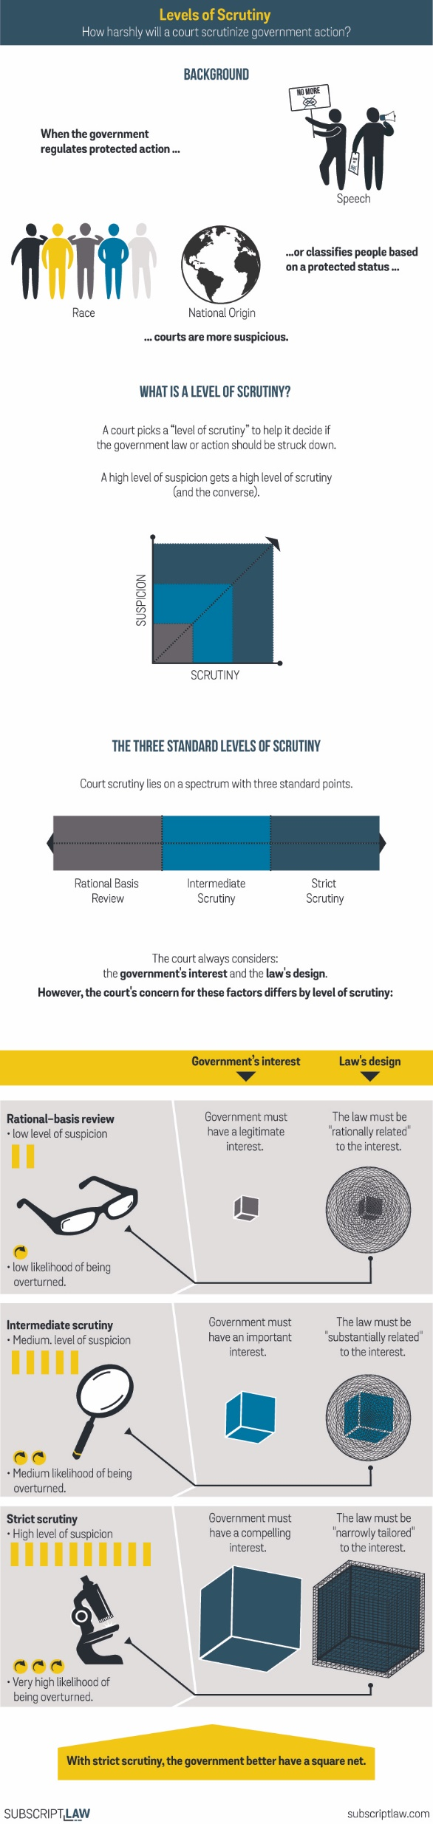
Strict Scrutiny
Under current cases, the 14th Amendment’s Equal Protection Clause gives some protection against sex discrimination, but not as much as against race discrimination.
And even those cases are in question. Some justices believe the 14th Amendment should not apply to sex at all, because its authors did not have sex equality in mind.
According to the late Justice Scalia, “Certainly the Constitution does not require discrimination on the basis of sex. The only issue is whether it prohibits it. It doesn’t.”

Slide 22
AJ Conroy
State Law Audit Project
stateoutreach@eracoalition.org
312.405.4538

